Slide 1
Travel Claim Insurance
By: Alicia Lizarraga

Slide 2
Background Information
Source:
-(Kaggle) DataSet: https://www.kaggle.com/datasets/mhdzahier/travel-insurance
Stakeholder: A third-party travel insurance servicing company that is based in Singapore
Objective: To see if clients have actually claimed their travel insurance and with which company.

Slide 3

What is travel insurance?
Travel insurance is a plan you purchase that protects you from certain financial risks and losses that can occur while traveling. These losses can be minor, like a delayed suitcase, or significant, like a last-minute trip cancellation or a medical emergency overseas.

Slide 4
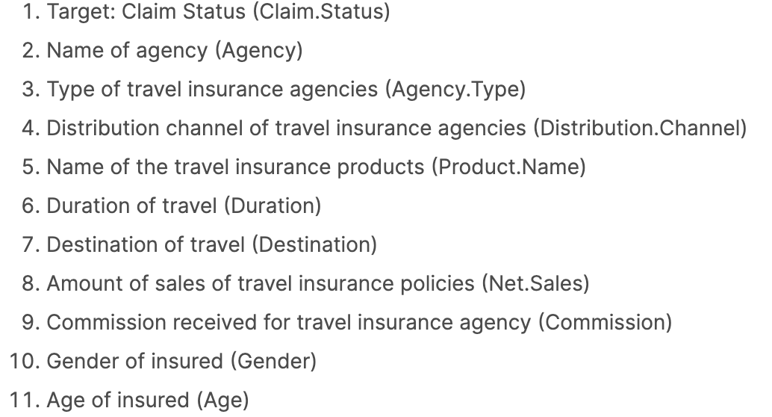
DataSet

Slide 5
Visual

Slide 6
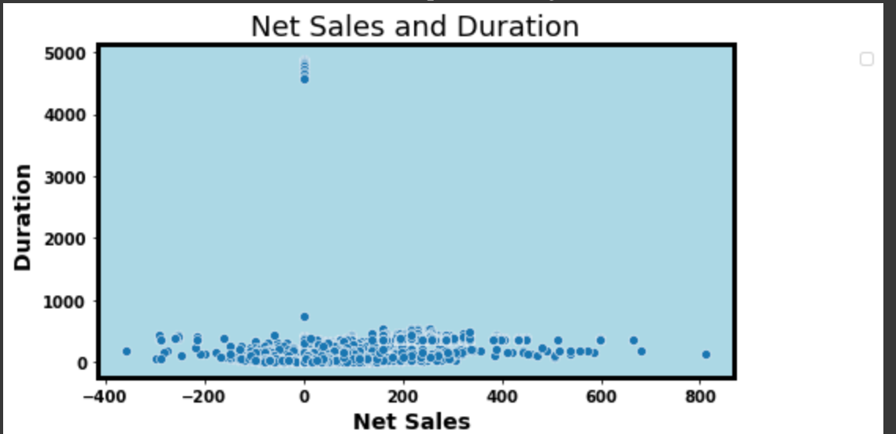

Slide 7
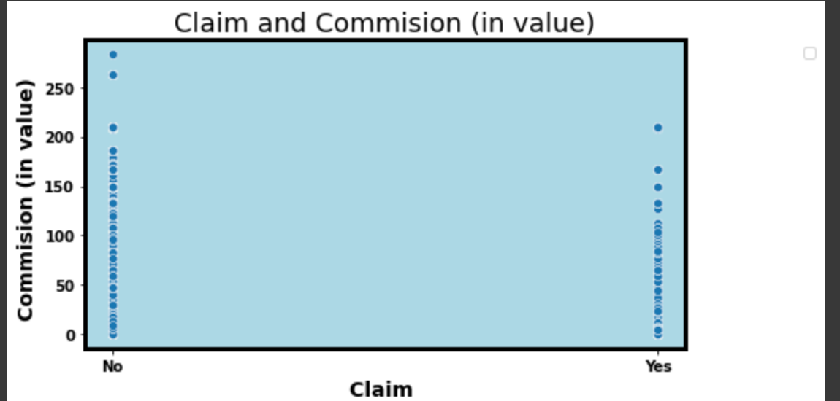

Slide 8
Chosen Model
Logistic Regression model is recommended because it had a
Training score: 0.98%
Testing Score: 0.97%

Slide 9
Limitations

Slide 10
Original Data: Classification
For the class balance, I wouldn’t rely on this dataset because of the missing data.
More than 50% of data was missing from one column

Slide 11
Strengths

Slide 12
Test Scores
Results from modeling and doing machine learning, found that the test results came out with very high scores or high scores in accuracy.
So predictions could very well be great to use on future data that’s collected

